Slide 1

neural network In python
tensorflow

Slide 2
Outline
Machine Learning
Exercise
Basic Neural network
Loss, Gradient Descent, Backpropagation,and etc
Convolutional Neural Network
Recurrent Neural Network

Slide 3

COMPA Vision
“We want a self learning system (Networks/Support solutions) that is automated, proactive and seldom requires manual intervention, throughout the entire lifecycle of supported products and services.”

Slide 4















Machine Learning
50B Devices
Why:
Vast amounts of data, changing environments
Difficult to capture all variations manually and timely
What:
Web page ranking, Movie recommendations, ..
Autonomous vehicles (e.g. helicopters), Robotics, …
Network traffic classification, Intrusion detection, …
Smart networks, 50 billion devices, services
When:
Human expertise does not exist.
Humans are unable to explain their expertise.
Solution needs to be adapted to particular cases or change in time.
Solutions highly complex, multi dimensional, unknown correlations.
Millions of Services

Slide 5
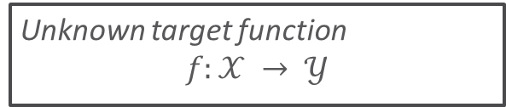
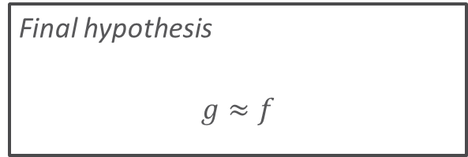
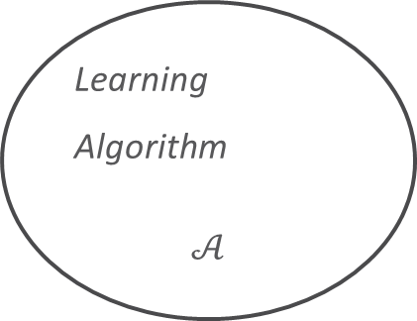
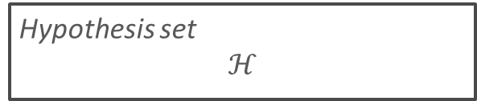

Types of Learning
Supervised learning:
Example inputs and desired outputs are given.
Goal to learn a rule that maps inputs to outputs.
Unsupervised learning:
No labels are given to the learning algorithm.
Goal is to find structure or hidden patterns.
Unknown target function
$$f:𝒳 → 𝒴$$
Training examples
$$(x_{1},y_{1}), …,(x_{n},y_{n}),$$
Learning
Algorithm
$$𝒜$$
Final hypothesis
$$g≈f$$
Hypothesis set
$$ℋ$$

Slide 6
Machine Learning Tasks
Classification
Regression
x₂
x₂
x₁
x₁
Clustering
Anomaly Detection
x₂
x₂
x₁
x₁

Slide 7
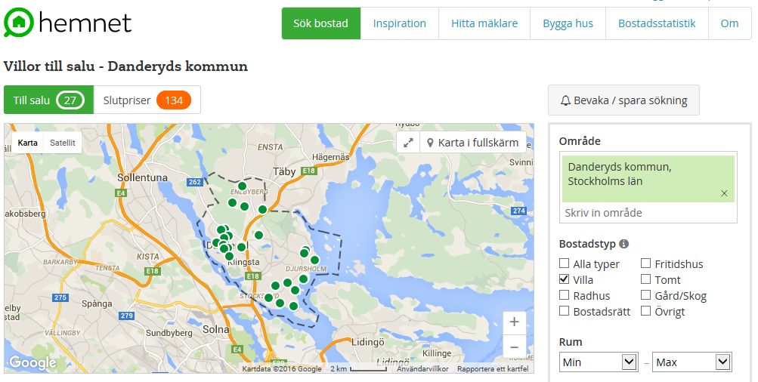
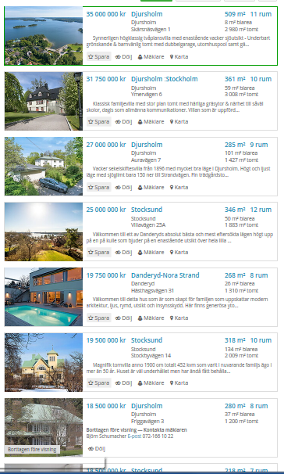
Example: Supervised Learning
Data:
www.hemnet.se
2016-05-15, 18:00
Danderyds kommun
27 houses
Price and Size

Slide 8
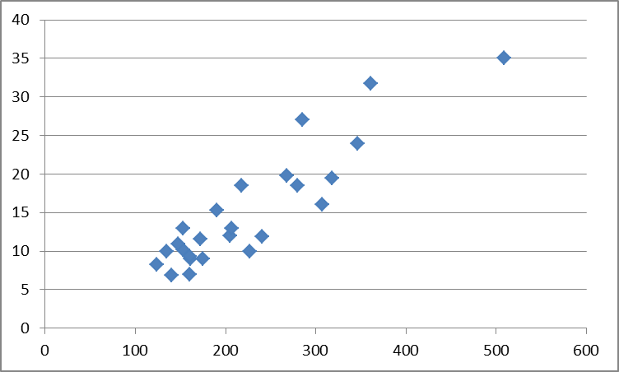
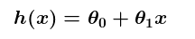
Example: Supervised Learning
House Price in Danderyd in MSEK
Task:
Predict house price
Find over-/underpriced houses
Machine to learn relation between size and price.
Square meter
Linear function

Slide 9
Example: Supervised Learning
House Price in Danderyd in MSEK
BUT: It is not sufficient to just evaluate the size of the house to predict the price.
More parameters:
Square meters house(x1)
Number of rooms (x2)
Square meters garden (x3)
Distance to waterfront (x4)
And more…
➔5 Dimensions not possible for humans to visualize and to fit
Square meter
Logistic or high Polynomial function needed

Slide 10
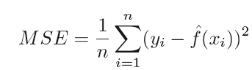
Example: Supervised Learning
House Price in Danderyd in MSEK
Selecting and fitting the Hypothesis function h(x):
Minimize Mean Squared Error
Supervised Learning: “y” is known from training set
Red: high variance, training error low
Blue: high bias, training error high
Square meter
➔ But how des h(x) perform with unknown data?

Slide 11
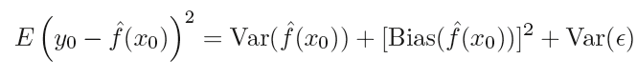
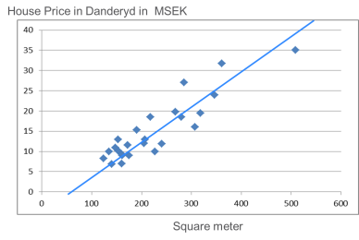
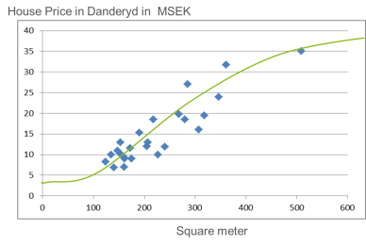
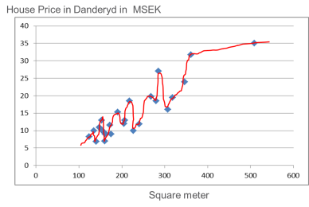
Bias vs. Variance
Model needs to work with unseen data (and test samples), not only with the training samples.
Expected test MSE:
To reduce error, select model with low Bias and low Variance
Test Sample
Model Prediction Error
Training Sample
High Bias Low Variance
Low Bias High Variance
Model Complexity

Slide 12
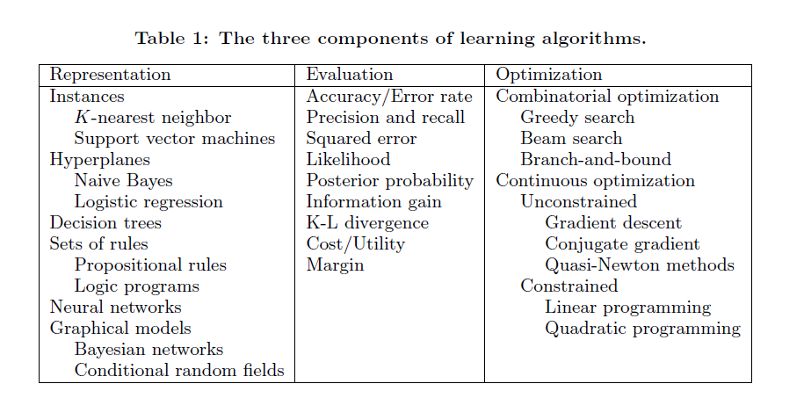
algorithms
Notes:
Representation of the hypothesis
Evaluation of good vs. bad hypothesis
Optimization or search for the best hypothesis

Slide 13
Data analytics methodology
Data Service
Data scientists
Analytics Service
Raw Data
Pre-processing & Filtering
Statistical Analysis
Machine Learning
Validation
Insights
Deployment
User & Device Data
Visualization
inputs
Network Data
Business Decision
Service Data

Slide 14
task
Implement
2 layers neural network Neurons
Classify spiral dataset
Example
http://playground.tensorflow.org

Slide 15
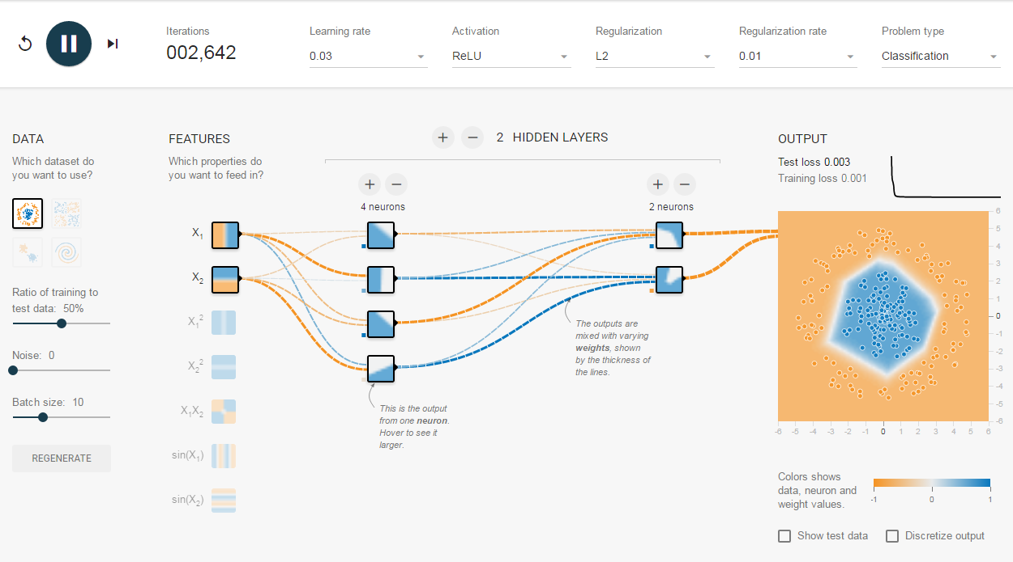
Neurual network

Slide 16
Neural network
b1
hidden
b0
h1
Naming conventions
Input layer, hidden layer, output layer
Neurons
Activation function
Weights, biases
Classifier example
2 layers neural network, 2D input layer, 2 classes output
Activation function ReLu, max(0, X)
h₁ = x₁w₁₁ + x₂w₂₁ + b₁₁ h₂ = x₁w₁₂ + x₂w₂₂ + b₁₂ …
w₁₁
input
w₂₁
output
x1
h2
o1
x2
h3
o2
h4
w₁₁ | w₁₂ | w₁₃ | w₁₄
w₂₁ | w₂₂ | w₂₃ | w₂₄
Point =
X₁ | X₂
W₁ =
b₁ =
b₁₁ | b₁₂ | b₁₃ | b₁₄
H = max(0, Point * W₁ + b₁)
O = H * W₂ + b₂

Slide 17
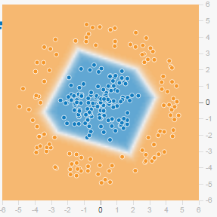
Neural network
b1
How it works
Here is one trained W and b
Point2
hidden
b0
h1
-0.89 | -0.48
-0.73 | -0.42
-1.1 | -0.58
1.5 | 0.74
w₁₁
input
w₂₁
output
x1
h2
o1
0.14 | -0.58 | 1.1 | 0.3
-1.1 | 0.72 | 0.55 | 0.05
Point1
W₁ =
W₂ =
x2
h3
o2
b₁ =
-0.14 | -0.22 | -0.26 | 1.7
b2 =
0.74 | 0.5
h4
Point1 = (0.0 0.0)
Output1 = (3.2 1.76)
o1 > o2, inside circle, classified as blue
Point2 = (0.0 6.0)
Output2 = (-2.597 -1.5052)
o1 < o2, outside circle, classified as orange

Slide 18
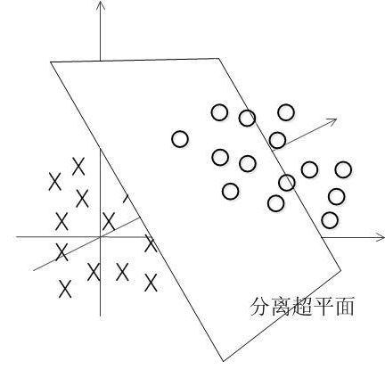
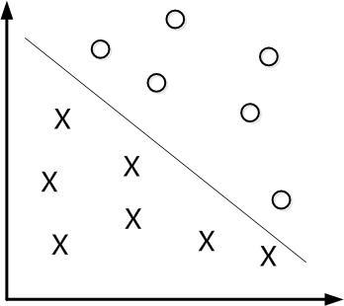
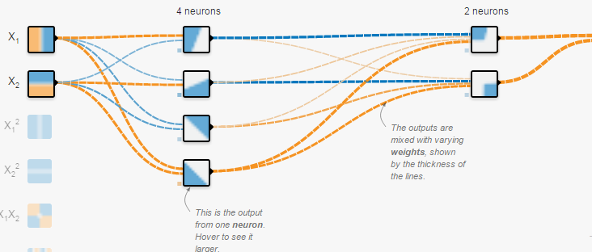
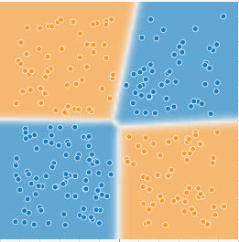
Intuition Neural network(1/3)
H = X * W + b
2D, line
3D, plane
Higher Dimension, hyper-plane
Why b(bias) is needed
Shift the activation function to left/right
If b =0, all line/plane/hyper-plane go through zeros, might not be able to separate data set
Neurons
each neuron is a classifier

Slide 19
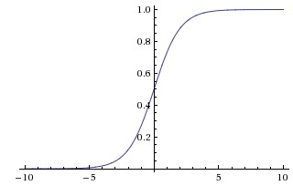
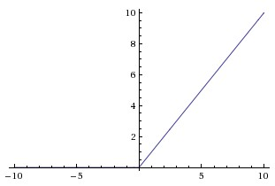
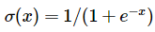
Intuition Neural network(2/3)
Commonly used activation function
Sigmoid (non-linear)
ReLu (linear)
Sigmoid
Sigmoids saturate and kill gradients.
Sigmoid outputs are not zero-centered
Slow convergence
ReLu
f(x) = max(0,x)
Greatly accelerate the convergence of stochastic gradient descent
Simple in implementation
Can be fragile during training and can “die”
Sigmoid
ReLu

Slide 20
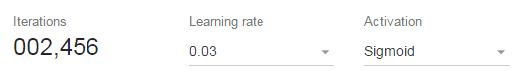
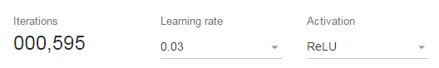
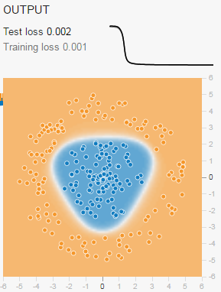
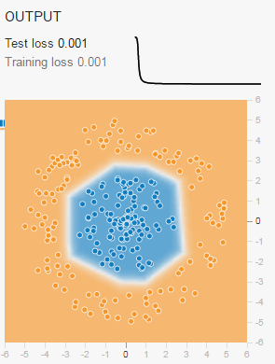
Intuition Neural network(3/3)
Sigmoid vs ReLu, training loss 0.001
ReLU takes less iterations. i.e. less time
Sigmoid’s decision boundary is smooth

Slide 21
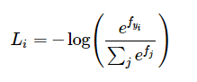
Loss function(1/2)
Loss function
Loss function quantifies our unhappiness with the computed class scores. Intuitively, we want the correct class to have a higher score than the other classes. There are many ways to quantify this intuition, but in this example lets use the cross-entropy loss
Cross-entropy
http://colah.github.io/posts/2015-09-Visual-Information/
Example
Actual label of Point1 (0.0, 0.0) is blue. i.e. expected out put is (1, 0)
If we predicted correct, output is (3.2, 1.76), L₀ = -log(exp(3.2) / (exp(3.2) + exp(1.76) )) = 0.213
If we predicted wrong, assume output is (-2.597, -1.5052), the L₀ = 1.381

Slide 22
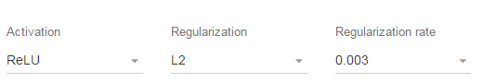
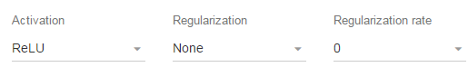
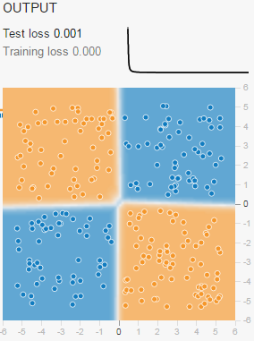
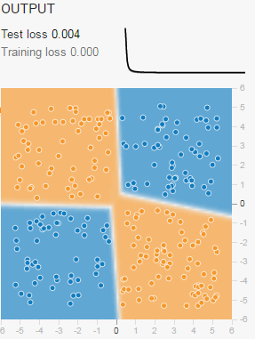
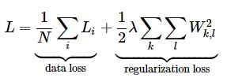
Loss function(2/2)
Regularization
Intuitively, to prevent overfit of model
For mathematics explanation, please google
The full loss function is
The target is to minimize the loss function

Slide 23
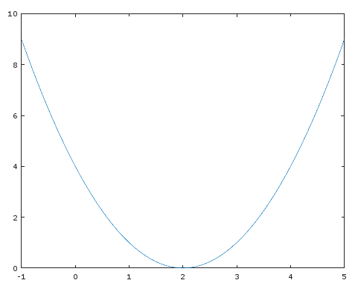
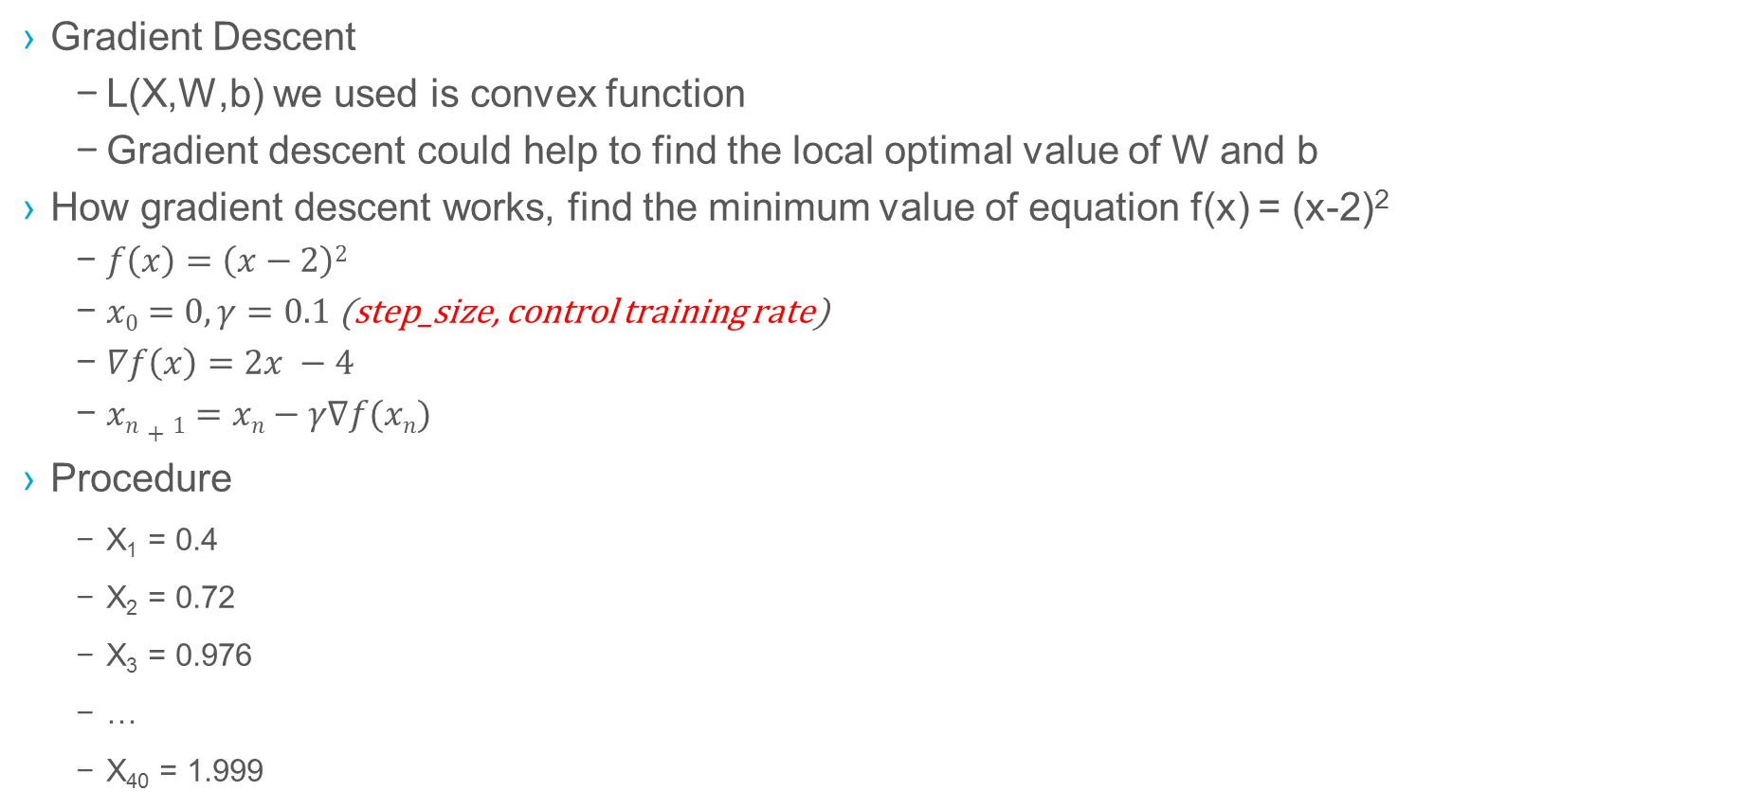
Gradient Descent
Gradient Descent
L(X,W,b) we used is convex function
Gradient descent could help to find the local optimal value of W and b
How gradient descent works, find the minimum value of equation f(x) = (x-2)²
$f\left(x\right)=\left(x−2\right)2$
$x0=0, γ=0.1$ (step_size, control training rate)
$∇f\left(x\right)=2x −4$
$xn+1=xn−γ∇f(xn)$
Procedure
X₁ = 0.4
X₂ = 0.72
X₃ = 0.976
…
X₄₀ = 1.999

Slide 24
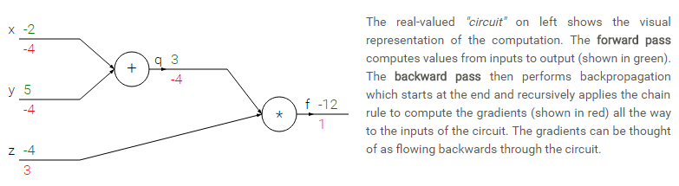
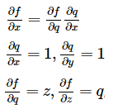
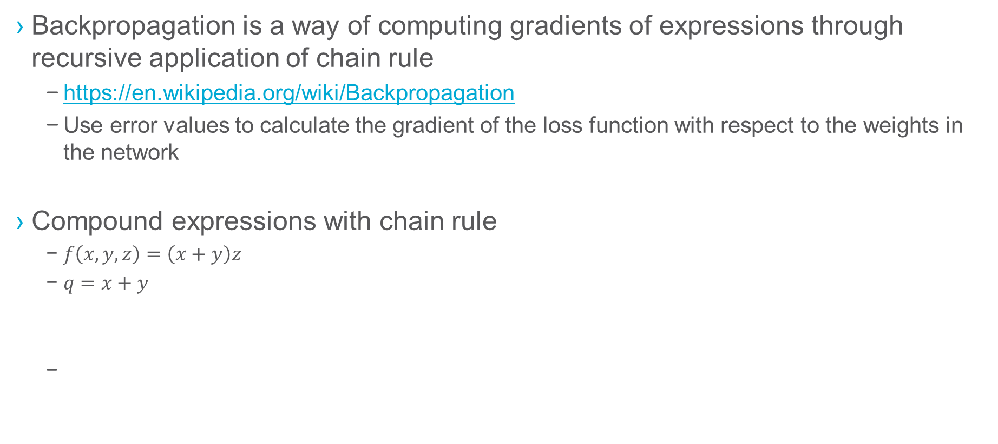
Backpropagation(1/2)
Backpropagation is a way of computing gradients of expressions through recursive application of chain rule
https://en.wikipedia.org/wiki/Backpropagation
Use error values to calculate the gradient of the loss function with respect to the weights in the network
Compound expressions with chain rule
$f\left(x,y,z\right)=\left(x+y\right)z$
$q=x+y$

Slide 25
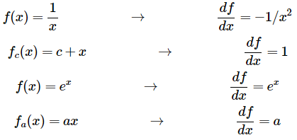
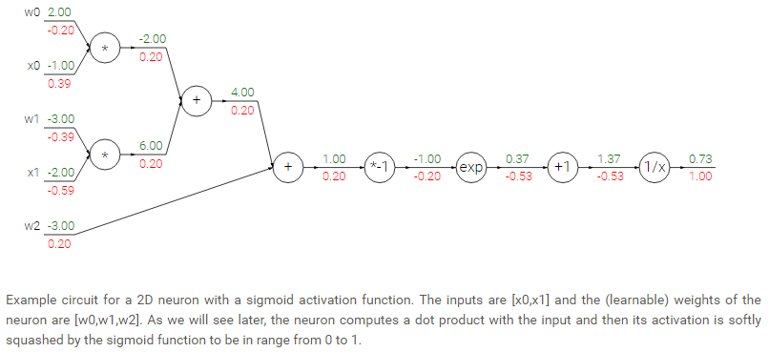
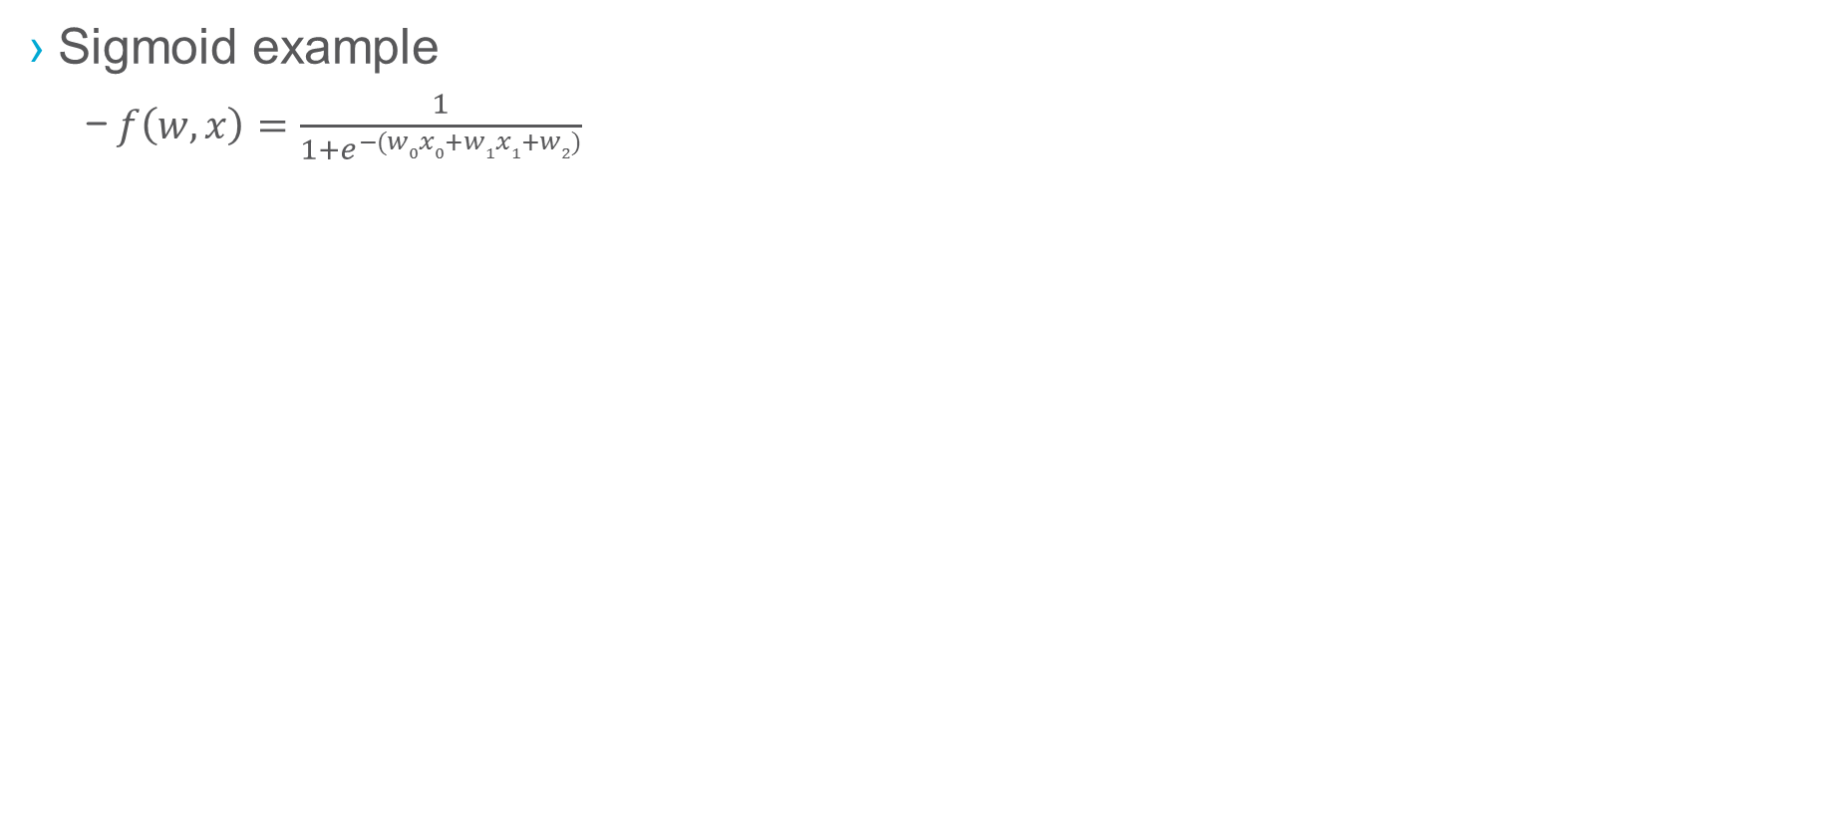
Backpropagation(2/2)
Sigmoid example
$f\left(w,x\right)=\frac{1}{1+e^{−(w0x0+w1x1+w2)}}$

Slide 26
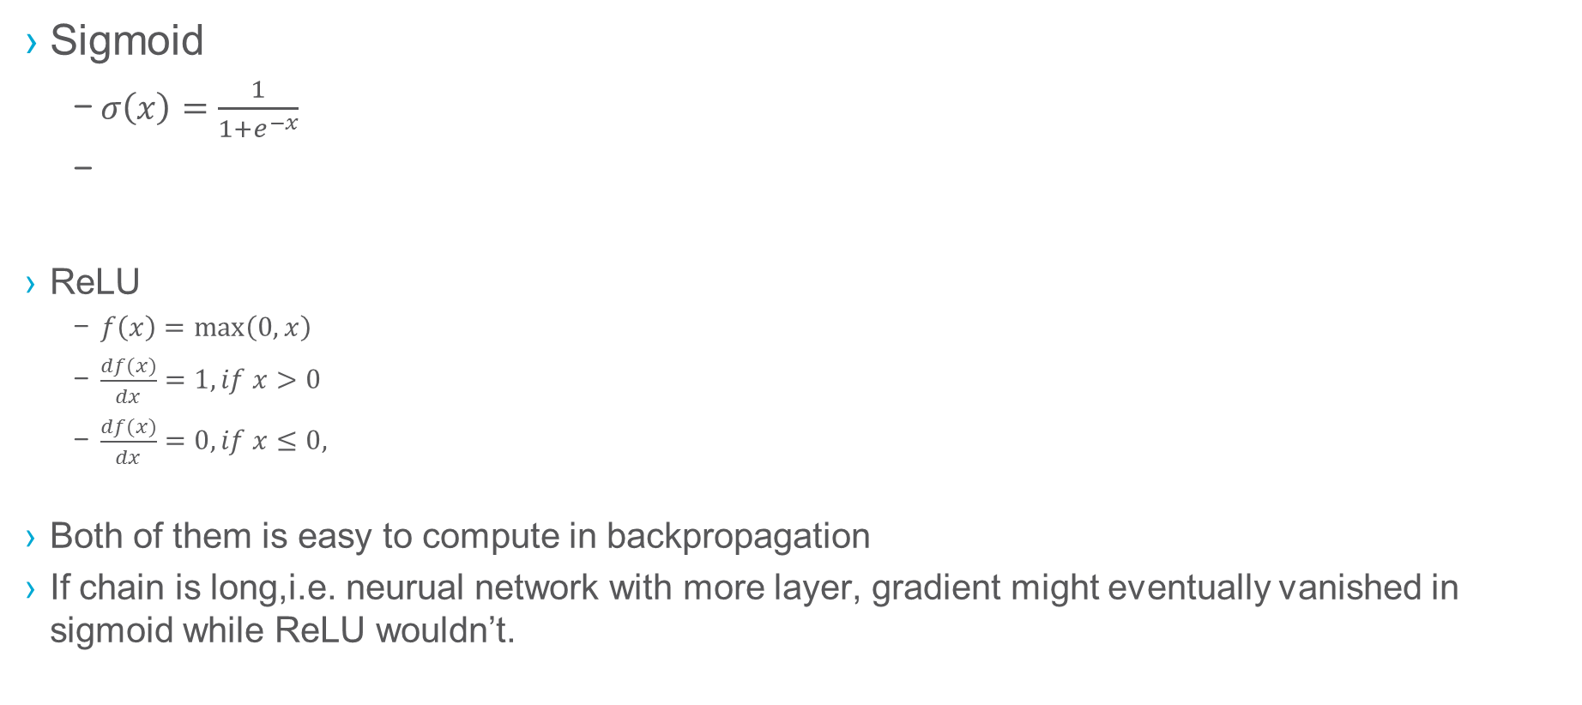
Sigmoid vs relu
Sigmoid
$σ\left(x\right)=\frac{1}{1+e^{−x}}$
ReLU
$f\left(x\right)=\max\left(0,x\right)$
$\frac{df(x)}{dx}=1, if x>0$
$\frac{df(x)}{dx}=0, if x≤0,$
Both of them is easy to compute in backpropagation
If chain is long,i.e. neurual network with more layer, gradient might eventually vanished in sigmoid while ReLU wouldn’t.

Slide 27
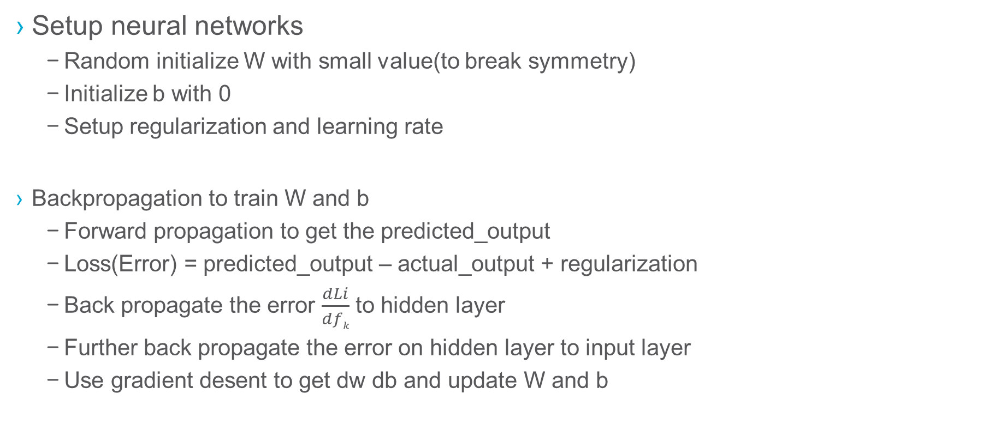
All in one
b1
Setup neural networks
Random initialize W with small value(to break symmetry)
Initialize b with 0
Setup regularization and learning rate
Backpropagation to train W and b
Forward propagation to get the predicted_output
Loss(Error) = predicted_output – actual_output + regularization
Back propagate the error $\frac{dLi}{dfk}$ to hidden layer
Further back propagate the error on hidden layer to input layer
Use gradient desent to get dw db and update W and b
hidden
b0
h1
w₁₁
input
w₂₁
output
x1
h2
o1
x2
h3
o2
h4

Slide 28
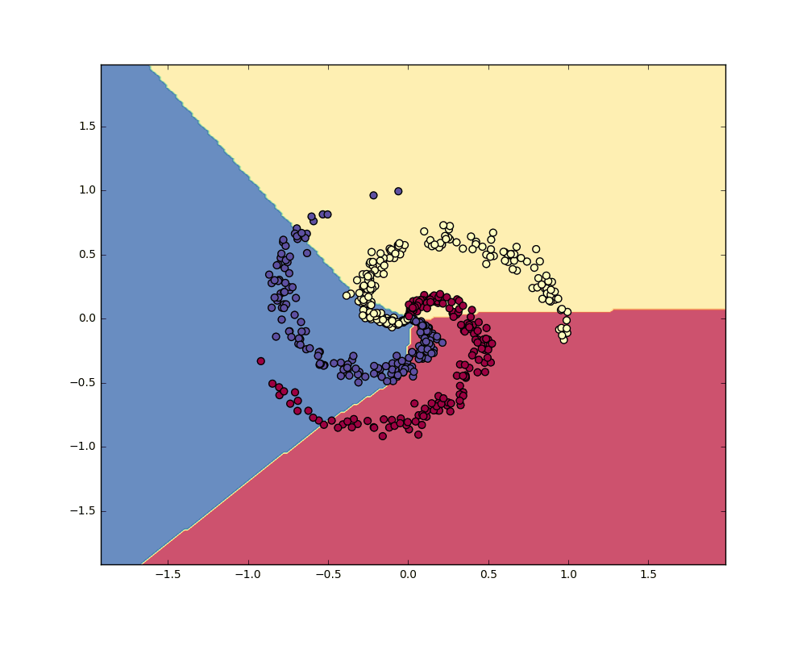
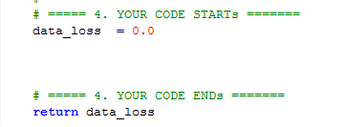
exercise
Implement neural network to classify spiral data
2 layer neural network
100 neurons in hidden layer
3 outputs
Complete all “YOUR CODE” part
Demo

Slide 29
Exercise 1
Initialize weight and bias matrix with correct dimension
vectorization could speed up the training
Recall in the previous example
2 input, 4 hidden and 3 output
two weight matrix W1 and W2
W1 2 * 4, W2 4 * 2
Two bias matrix
B1 1 * 4, B2 1 * 2
b1
hidden
b0
h1
w₁₁
input
w₂₁
output
x1
h2
o1
x2
h3
o2
h4

Slide 30
Exercise 2
Implement calculation for hidden layer
Recall in class
Hints
Relu, numpy.maximum(0, x)
matrix multiply, numpy.dot(A, B)
If you are not familiar with matrix operation, you could also use loop, but it is not recommended
H = max(0, Point * W₁ + b₁)

Slide 31
Exercise 3
Implement calculation for output layer
Recall in class
O = H * W₂ + b₂

Slide 32
Reading 1
Please read function crossEntropy and try to understand
Hints
use numpy.shape to check the dimension of each variable
use help to see the doc of numpy lib, e.g help(numpy.sum)

Slide 33
Exercise 4
Implement data loss
The corss-entropy is already calculated by crossEntropy, what you need to do is implement the data loss part

Slide 34
Exercise 5
Implement regularization loss
The corss-entropy is already calculated by crossEntropy, what you need to do is implement the regularization loss part

Slide 35
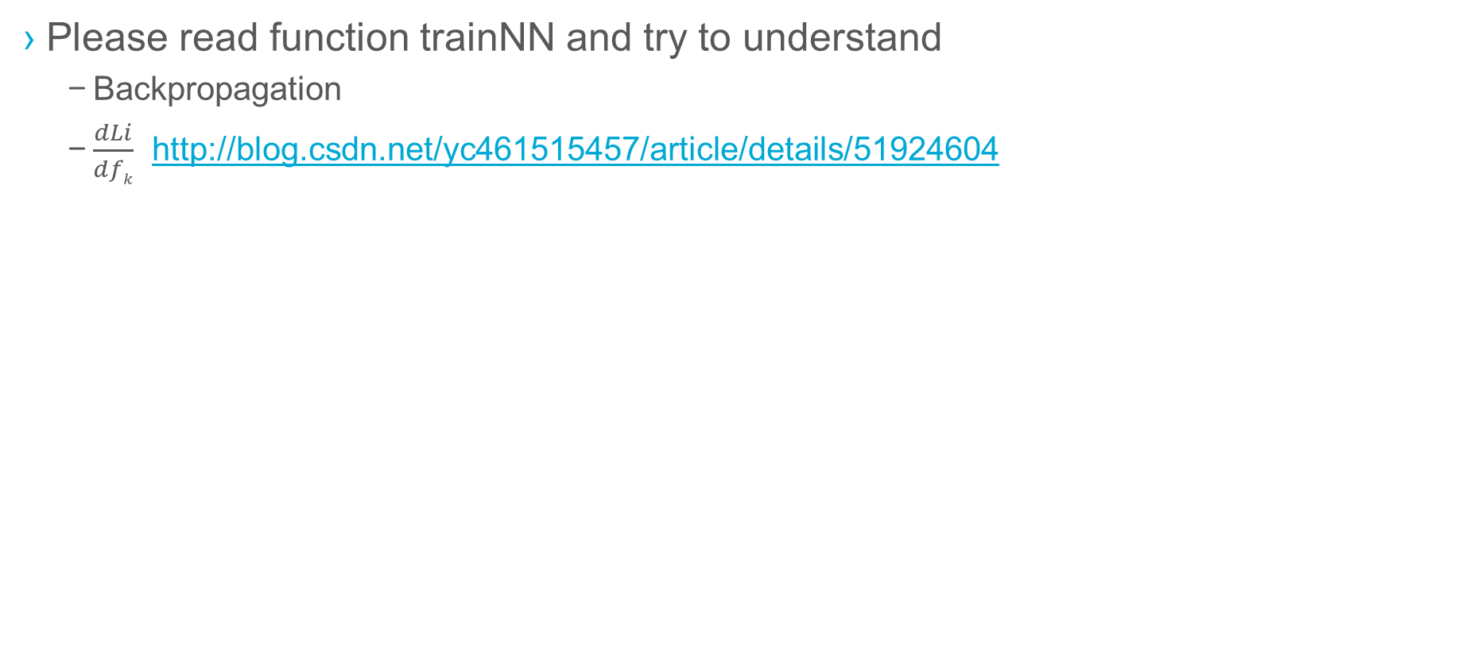
Reading 2
Please read function trainNN and try to understand
Backpropagation
$\frac{dLi}{dfk}$ http://blog.csdn.net/yc461515457/article/details/51924604

Slide 36
Exercise 6(optional)
Adjust training parameters to see the impact on loss and accuracy
h, hidden_layer size
step_size, training step A.K.A learning rate
reg, regularization

Slide 37

Mnist data
Database of handwritten digits
http://yann.lecun.com/exdb/mnist/
28 * 28 pixels, bilevel(black and white) image
10 classes

Slide 38
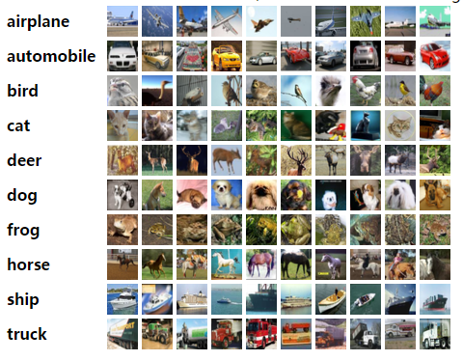
CIFAR-10 DATA
Database of labeled tiny image
http://www.cs.toronto.edu/~kriz/cifar.html
32 * 32 * 3 pixels, RGB image
10 classes

Slide 39

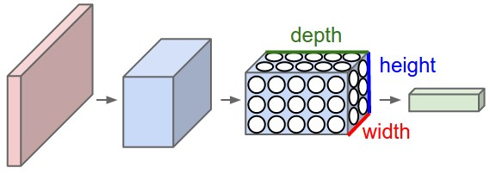
Convolutional Neural network
Backgroud
Regular Neural Nets don’t scale well to full images(e.g. 200x200x3, would lead to neurons that have 200*200*3 = 120,000 weights)
ConvNet
make the explicit assumption that the inputs are images
neurons arranged in 3 dimensions: width, height, depth.
the neurons in a layer will only be connected to a small region of the layer before it

Slide 40
Convolutional Neural network
ConvNet architectures
Convolutional Layer
Pooling Layer
Fully-Connected Layer(exactly as seen in regular Neural Networks)
Example architectures [INPUT - CONV - RELU - POOL – FC], CIFAR-10 dataset
INPUT [32x32x3] will hold the raw pixel values of the image, in this case an image of width 32, height 32, and with three color channels R,G,B.
CONV layer will compute the output of neurons that are connected to local regions in the input, each computing a dot product between their weights and a small region they are connected to in the input volume. This may result in volume such as [32x32x12] if we decided to use 12 filters.
RELU layer will apply an elementwise activation function, such as the max(0,x)max(0,x) thresholding at zero. This leaves the size of the volume unchanged ([32x32x12]).
POOL layer will perform a downsampling operation along the spatial dimensions (width, height), resulting in volume such as [16x16x12].
FC (i.e. fully-connected) layer will compute the class scores, resulting in volume of size [1x1x10], where each of the 10 numbers correspond to a class score, such as among the 10 categories of CIFAR-10. As with ordinary Neural Networks and as the name implies, each neuron in this layer will be connected to all the numbers in the previous volume.

Slide 41

Convolutional Neural network
Notes:
http://cs231n.stanford.edu/
https://www.zhihu.com/question/39022858

Slide 42

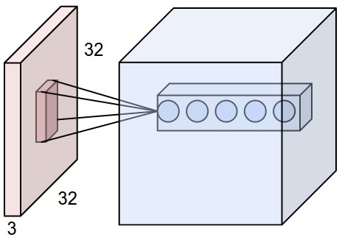
Convolutional layer
The Conv layer is the core building block of a Convolutional Network that does most of the computational heavy lifting.
Left: An example input volume in red (e.g. a 32x32x3 CIFAR-10 image), and an example volume of neurons in the first Convolutional layer. Each neuron in the convolutional layer is connected only to a local region in the input volume spatially, but to the full depth (i.e. all color channels). Note, there are multiple neurons (5 in this example) along the depth, all looking at the same region in the input - see discussion of depth columns in text below. Right: The neurons from the Neural Network chapter remain unchanged: They still compute a dot product of their weights with the input followed by a non-linearity, but their connectivity is now restricted to be local spatially.

Slide 43
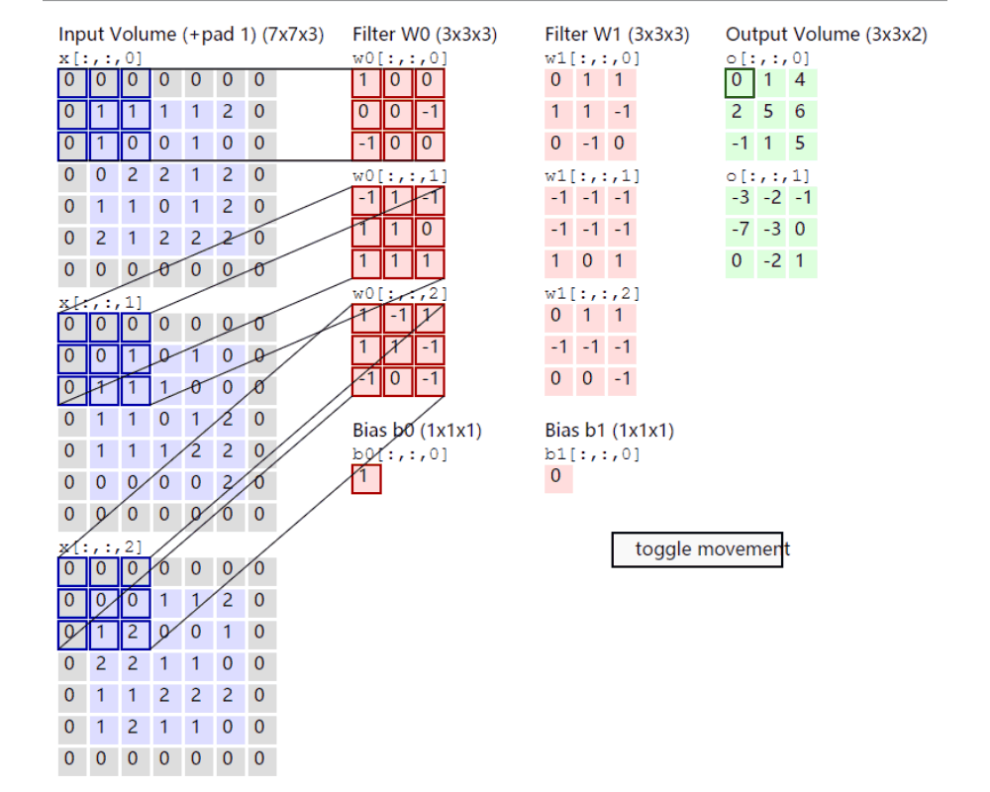
Convolutional layer
The Conv layer demo
Input 5*5*3
2 filters
height * width * depth = 3 * 3 * 2
* all neurons in a single depth slice are using the same weight vector

Slide 44



Convolutional layer
What is Filter ?
Template to extract characteristic from image
e.g. Prewitt, edge detection
Matlab code
orgImg = imread(‘test.bmp’);
edgeImg = edge(rgb2gray(orgImg),’prewitt’,0.06);
figure(1);imshow(orgImg);
figure(2);imshow(edgeImg);

Slide 45

Convolutional layer
Example filters learned by Krizhevsky et al. Each of the 96 filters shown here is of size [11x11x3], and each one is shared by the 55*55 neurons in one depth slice. Notice that the parameter sharing assumption is relatively reasonable: If detecting a horizontal edge is important at some location in the image, it should intuitively be useful at some other location as well due to the translationally-invariant structure of images. There is therefore no need to relearn to detect a horizontal edge at every one of the 55*55 distinct locations in the Conv layer output volume.

Slide 46


Pooling layer
It is common to periodically insert a Pooling layer in-between successive Conv layers to reduce the amount of parameters(less computation)

Slide 47
Other layers
Normalization Layer
Many types of normalization layers have been proposed for use in ConvNet architectures, sometimes with the intentions of implementing inhibition schemes observed in the biological brain. However, these layers have since fallen out of favor because in practice their contribution has been shown to be minimal
Fully-connected Layer
Neurons in a fully connected layer have full connections to all activations in the previous layer, as seen in regular Neural Networks. Their activations can hence be computed with a matrix multiplication followed by a bias offset. See the Neural Network section for more information.

Slide 48
Convolutional Neural network
In summary
A ConvNet architecture is in the simplest case a list of Layers that transform the image volume into an output volume (e.g. holding the class scores)
There are a few distinct types of Layers (e.g. CONV/FC/RELU/POOL are by far the most popular)
Each Layer accepts an input 3D volume and transforms it to an output 3D volume through a differentiable function
Each Layer may or may not have parameters (e.g. CONV/FC do, RELU/POOL don’t)
Each Layer may or may not have additional hyperparameters (e.g. CONV/FC/POOL do, RELU doesn’t)

Slide 49
exercises
Build CNN using tensorflow(TODO refine exercise)
https://github.com/dead911/tf_examples/blob/master/mnist_cnn.ipynb

Slide 50
Recurrent neural network
TBD
Agenda
Slides from Hilton(inventor of neural network)
Idea: recurrent -> memory
Hopfield, energy based (optional)
Restricted Boltzmann machine(optional)
Archtiecture
LSTM
Exercises
https://github.com/dead911/tf_examples/blob/master/tf_traffic_pred_lstm.ipynb

